Slide 1
Introduction to Electric and Electronics
Chapter 4 –
Transient Analysis

Slide 2
Learning Objectives
Learning Objectives
To understand the characteristics of capacitors and inductors
To learn how to reduce a network of either capacitors or inductors to a single capacitor or inductor
To understand the storage capability of these two elements
To understand the concept of time constant
To solve first-order transient circuits
To solve second-order transient circuits

Slide 3
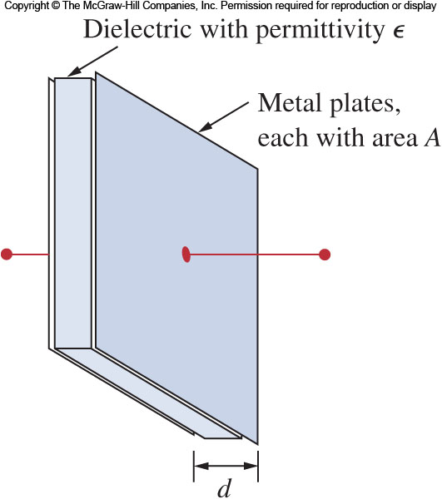
Capacitors
Capacitors
A capacitor is a passive element that stores energy in its electric field
It consists of two conducting plates separated by an insulator (or dielectric)
The plates are typically aluminum foil
The dielectric is often air, ceramic, paper, plastic, or mica

Slide 4
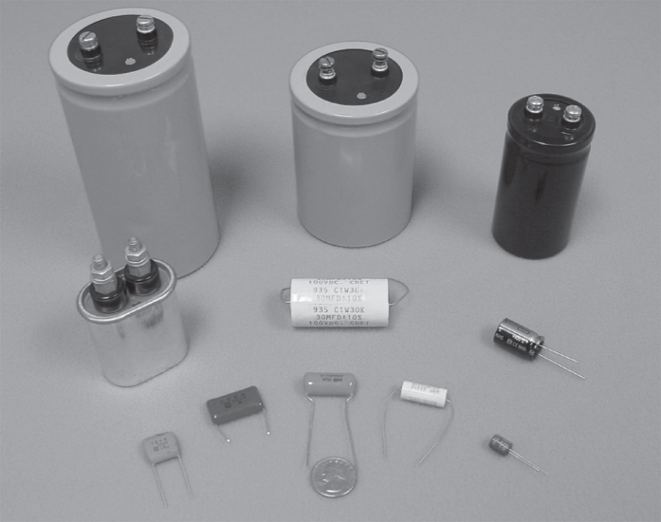
Capacitors
Capacitors
The unit of capacitance is the Farad (F)
One Farad is 1 Coulomb/Volt
Most capacitors are rated in picofarad (pF) and microfarad (μF)
Capacitance is determined by the geometery of the capacitor:
Proportional to the area of the plates (A)
Inversely proportional to the space between them (d)
ε is the permittivity of the dielectric

Slide 5
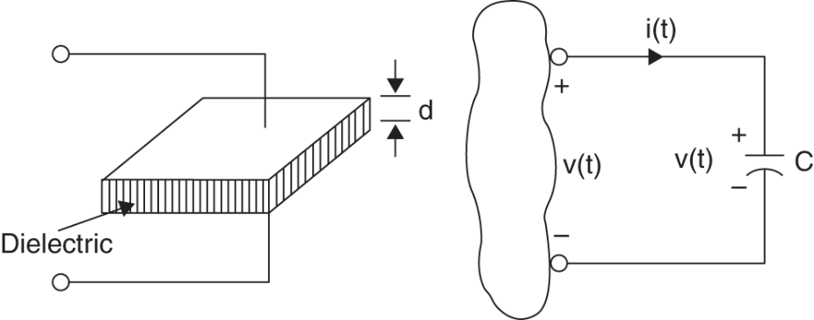

Capacitors
Current Voltage Relationship
The amount of charge is proportional to the voltage:
$$q\left(t\right)=Cv(t)$$

Slide 6
Capacitors
Store Charge
The instantaneous power delivered to the capacitor is
The energy stored in a capacitor is:

Slide 7
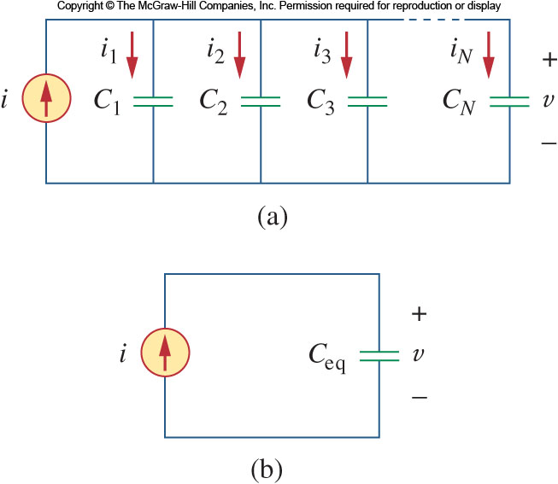

Capacitors
Parallel Capacitors
Starting with N parallel capacitors,
Applying KCL:
$$i=i_{1}+i_{2}+⋯+i_{N}$$
Taking the current voltage relationship
Thus $C_{eq}=C_{1}+C_{2}+⋯+C_{N}$

Slide 8
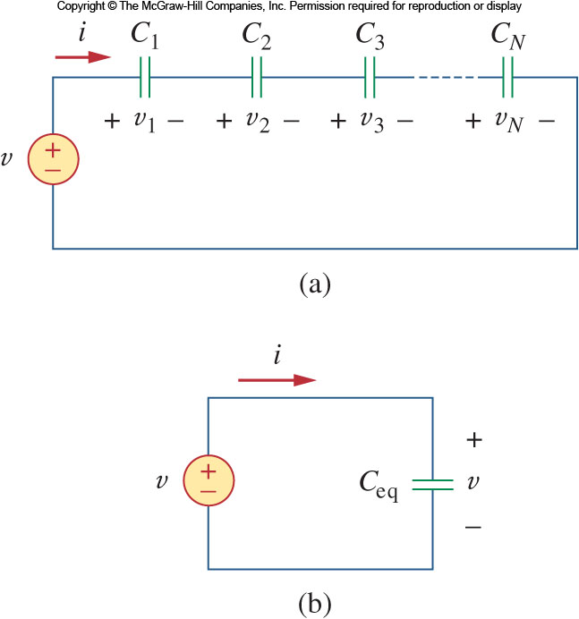

Capacitors
Series Capacitors
Turning to N series capacitors,
Applying KVL:
$$v=v_{1}+v_{2}+⋯{+ v}_{N}$$

Slide 9

Capacitors
Series Capacitors
Apply the voltage current relationship
Thus $\frac{1}{C_{eq}}=\frac{1}{C_{1}}+\frac{1}{C_{2}}+⋯+\frac{1}{C_{N}}$

Slide 10
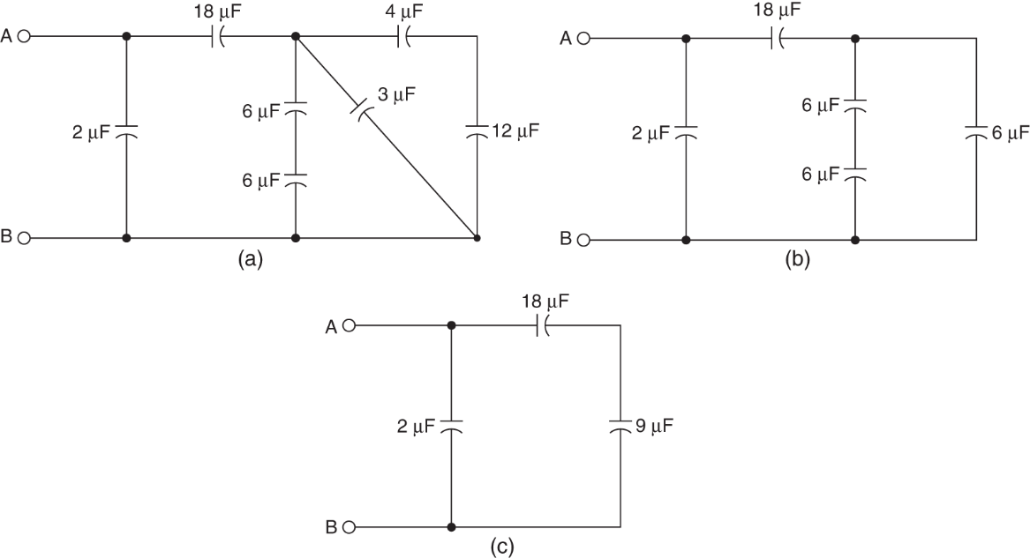
Capacitors
Example 4.1
Determine equivalent capacitance between A-B

Slide 11
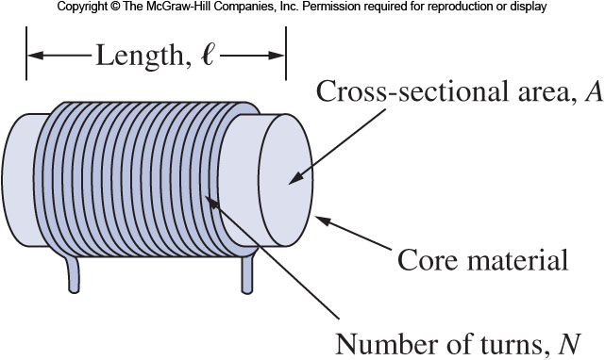
Inductors
Inductors
An inductor is a passive element that stores energy in its magnetic field
Calculating the inductance depends on the geometry:
For a solenoid the inductance is:
Where N is the number of turns of the wire around the core of cross sectional area A and length l.
The material used for the core has a magnetic property called the permeability, μ.

Slide 12

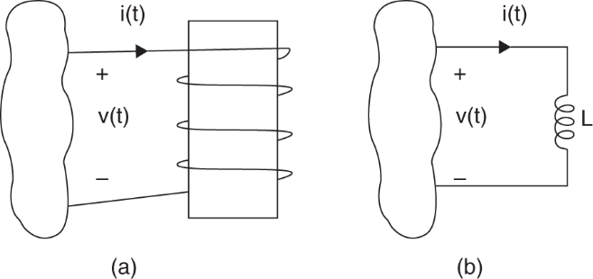
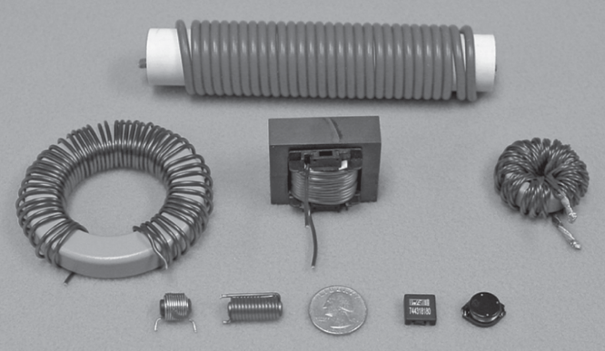
6.4 Inductors
Voltage Current Relationship
If a current is passed through an inductor, the voltage across it is directly proportional to the time rate of change in current
Where, L, is the unit of inductance, measured in Henries, H.
On Henry is 1 volt-second per ampere.
The voltage developed tends to oppose a changing flow of current.

Slide 13
Inductors
Store charge
The power delivered to the inductor is:
The energy stored is:

Slide 14
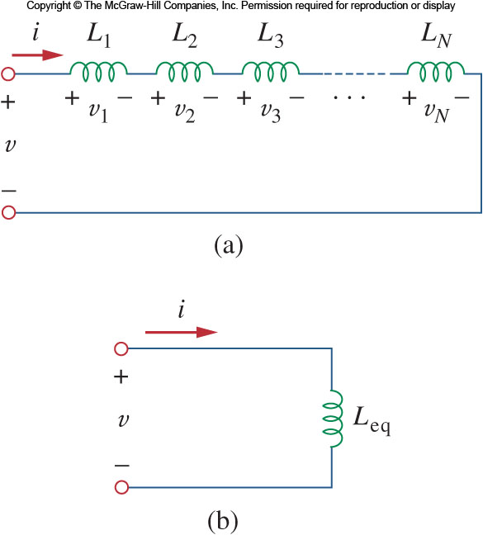

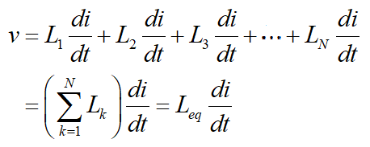

Inductors
Series Inductors
We now need to extend the series combinations to inductors
Applying KVL to the loop:
Taking the voltage current relationship
Thus

Slide 15
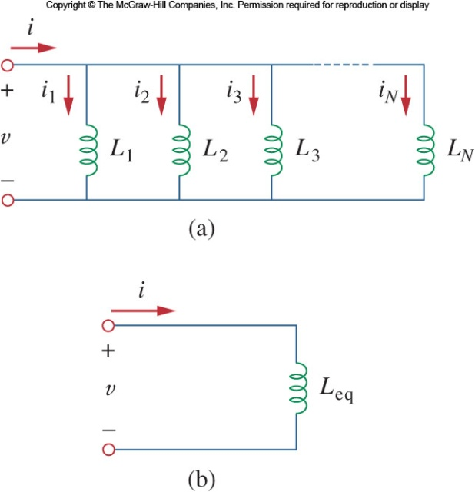


Inductors
Parallel Inductors
Applying KCL to the circuit:
the current voltage relationship
The equivalent inductance is thus:

Slide 16
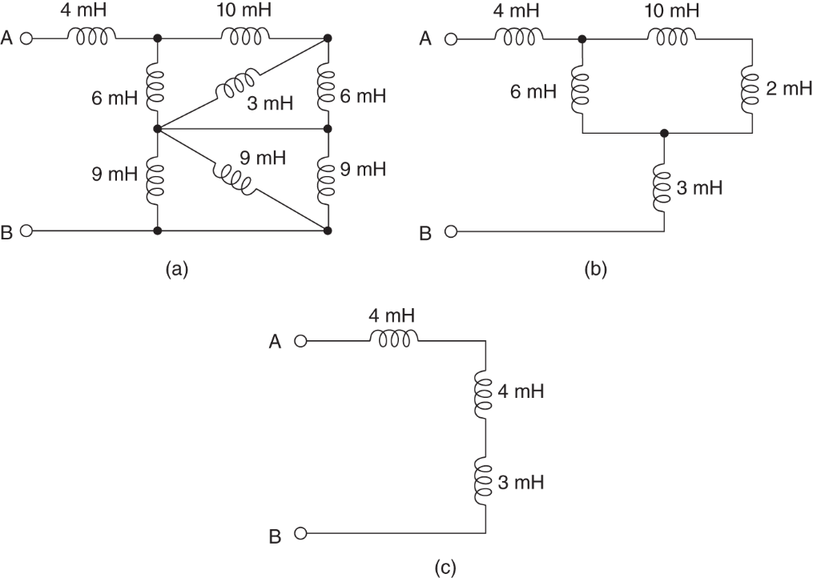
Inductors
Example 4.2
Determine equivalent inductance between A-B

Slide 17
Capacitor/Inductor Characteristics
Capacitor/Inductor Characteristics
Capacitor
If the voltage is constant, the current in the capacitor is zero and the capacitor looks like an open circuit
Inductor
If the current is constant, the voltage in the inductor is zero and the inductor looks like an short circuit

Slide 18
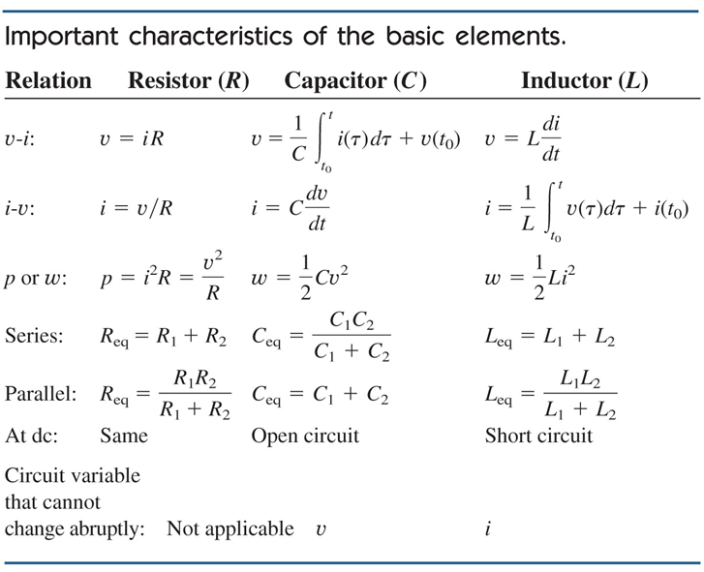
Capacitor/Inductor Characteristics

Slide 19
First Order Transient Circuits
First Order Transient Circuits
A first order circuit contain a single storage element, i.e. one capacitor or one inductor.
A first order circuit is characterized by a first order differential equation.
There are two types of first order circuits:
Resistive capacitive, called RC
Resistive inductive, called RL
We will assume the circuit is in a steady state prior to a circuit interruption.

Slide 20
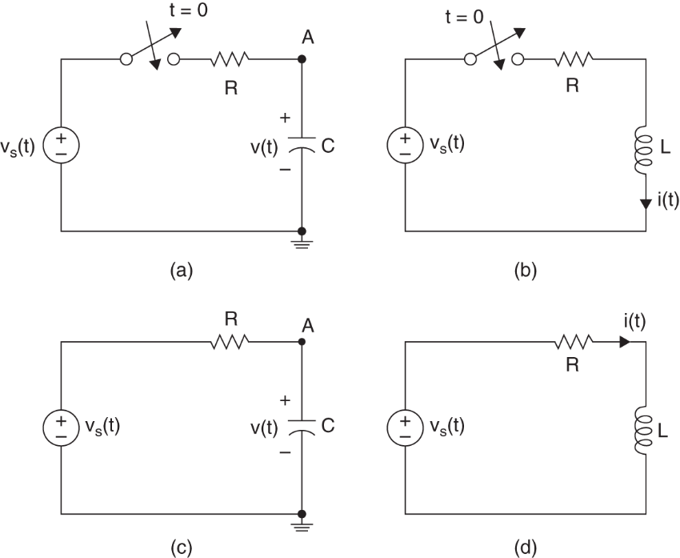
First Order Transient Circuits
RC and RL networks

Slide 21
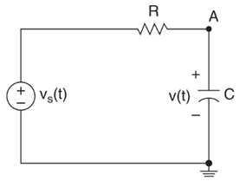
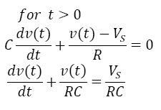
First Order Transient Circuits
RC network
Applying KCL at RC Circuit of Figure 4.7.c

Slide 22
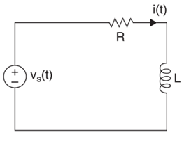
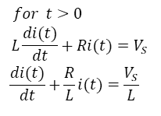
First Order Transient Circuits
RL network
Applying KVL at RL Circuit of Figure 4.7.d

Slide 23
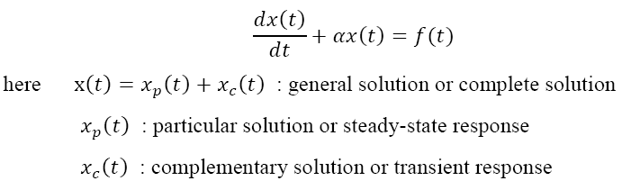

First Order Transient Circuits
Differential equation
In case of f(t) = A
Particular solution
Complementary solution

Slide 24

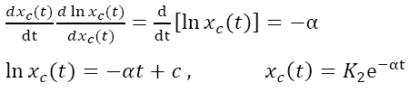
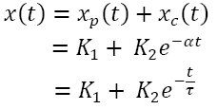
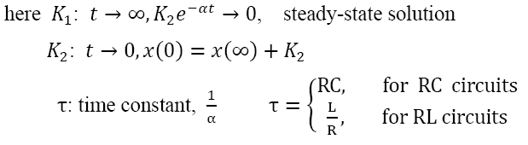
First Order Transient Circuits
Complementary(continue)
Complete solution

Slide 25
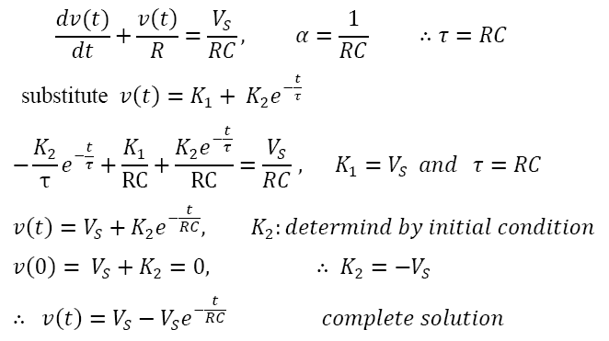
First Order Transient Circuits
Series RC Network Solution

Slide 26
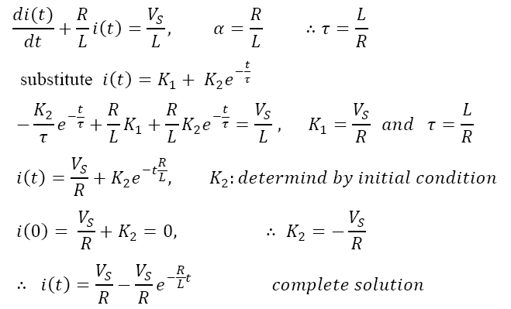
First Order Transient Circuits
Series RL Network Solution

Slide 27
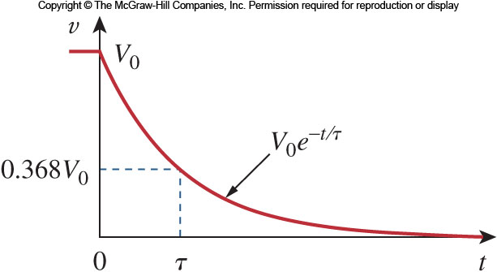
First Order Transient Circuits
Natural Response
The result shows that the voltage response of the RC circuit is an exponential decay of the initial voltage.
Since this is the response of the circuit without any external applied voltage or current, the response is called the natural response.

Slide 28
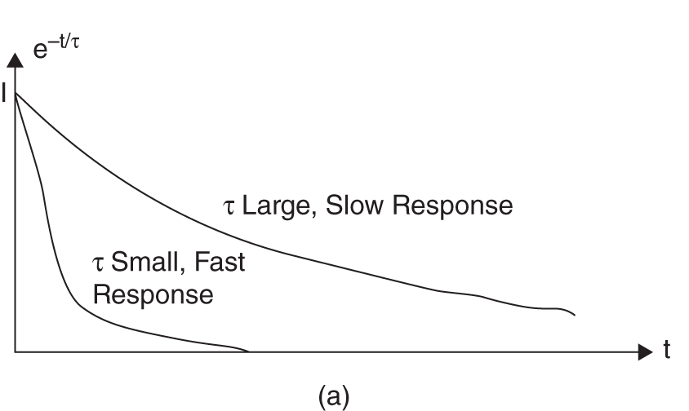
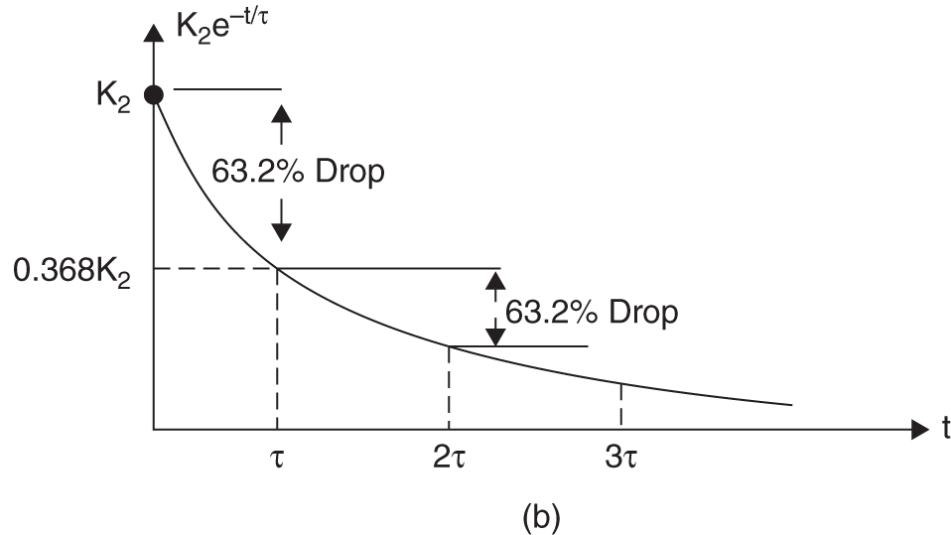
First Order Transient Circuits
Properties of time constant
The speed at which the voltage decays can be characterized by how long it takes the voltage to drop to 1/e of the initial voltage.
This is called the time constant and is represented by τ.
By selecting 1/e as the reference voltage:
The voltage can thus be expressed as:

Slide 29
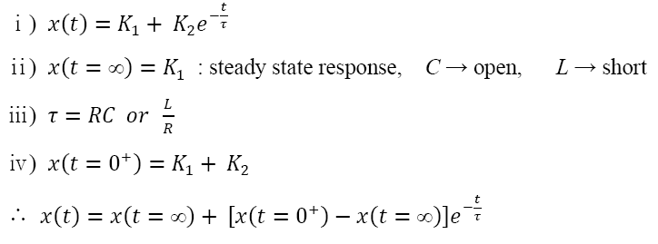
First Order Transient Circuits
The Analysis Procedure

Slide 30
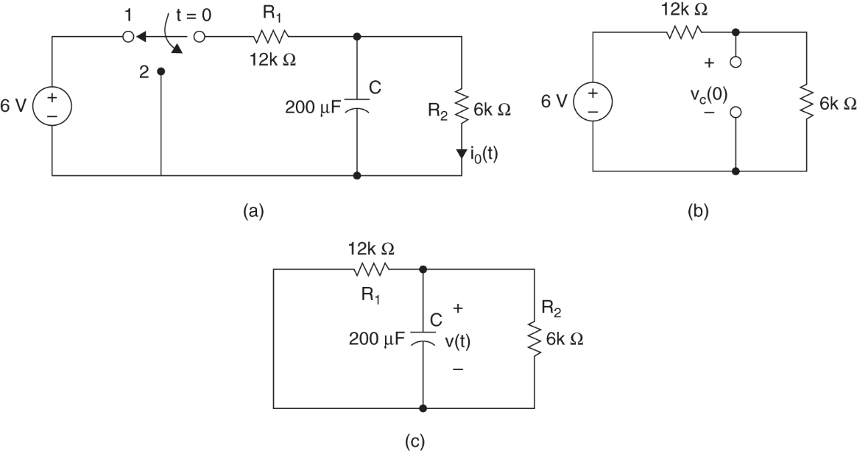

First Order Transient Circuits
Example 4.3
Fine the output current $i_{0}\left(t\right), for t>0$.

Slide 31
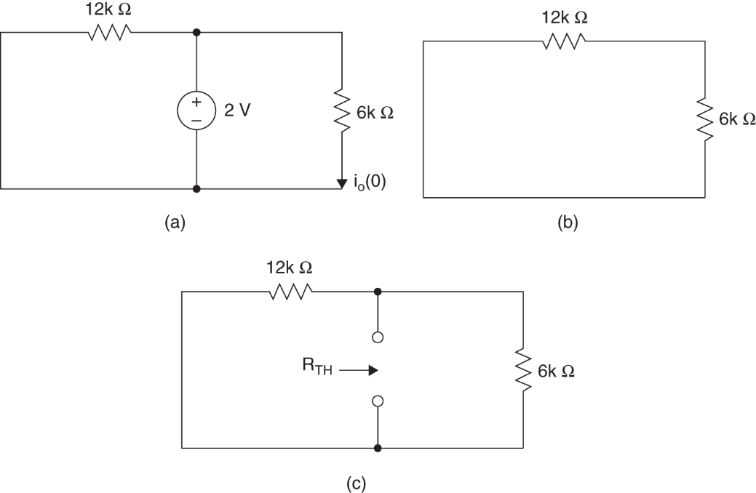

First Order Transient Circuits
Example 4.4
Fine the output current $i_{0}\left(t\right), for t>0$.

Slide 32
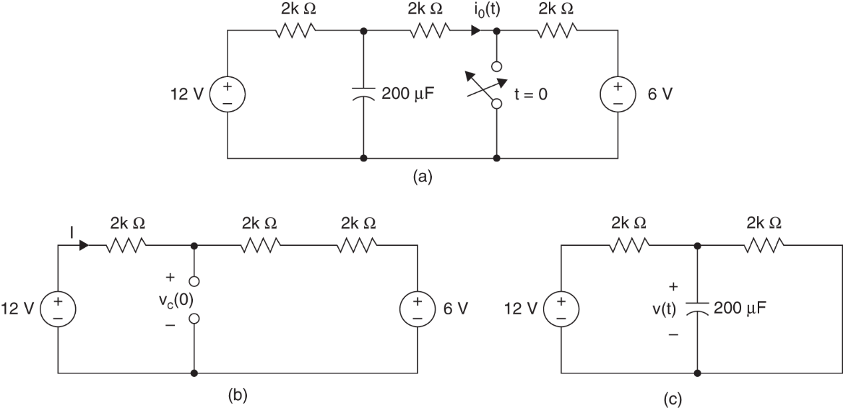

First Order Transient Circuits
Example 4.5
Determine the voltage $v_{0}\left(t\right), for t>0$.

Slide 33
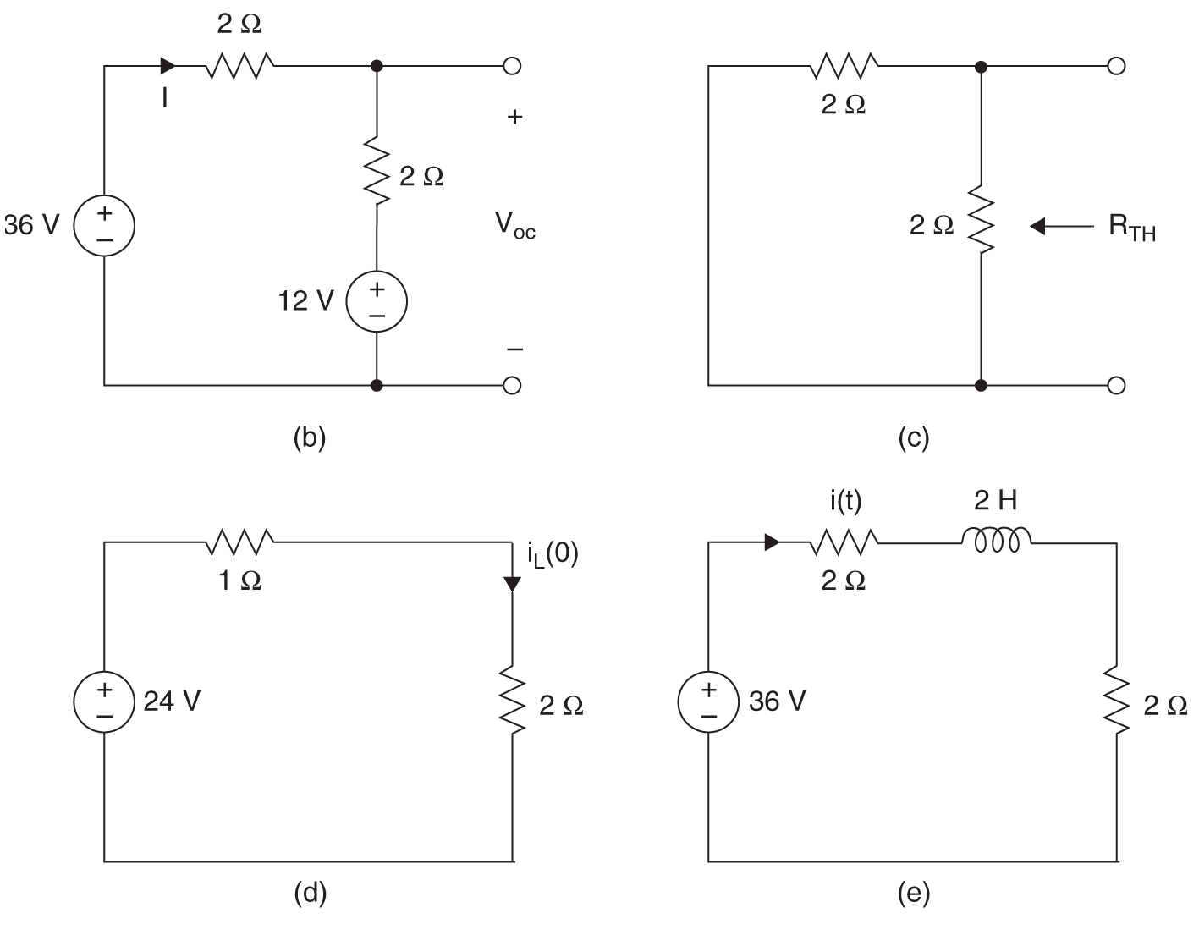
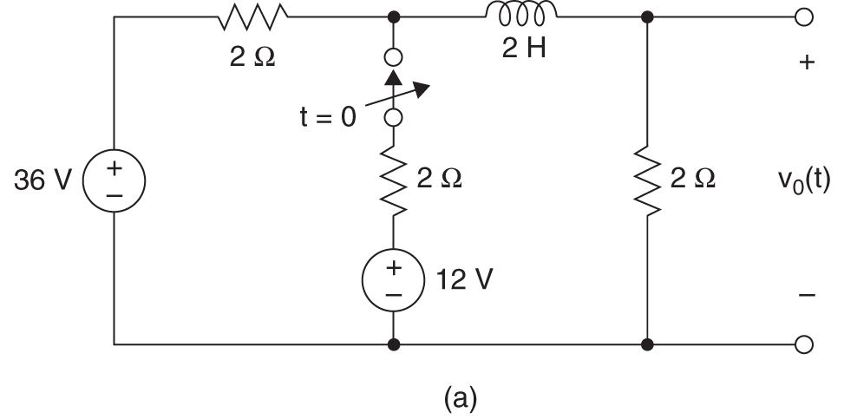

First Order Transient Circuits
Example 4.6
Determine the voltage $v_{0}\left(t\right), for t>0$.

Slide 34
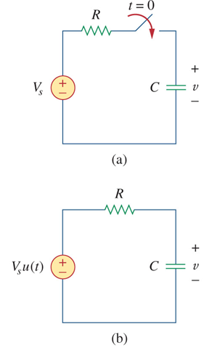
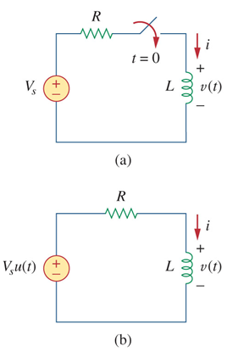
First Order Transient Circuits
Step Response of a RC or RL Circuit
When a DC source is suddenly applied to a RC or RL circuit, the source can be modeled as a step function.
The circuit response is known as the step response.

Slide 35
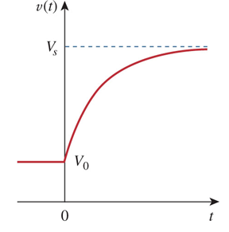
First Order Transient Circuits
Step Response of RC Circuit
We assume an initial voltage of V₀ on the capacitor.
Applying KCL:
For t>0 this becomes:
Integrating both sides and introducing initial conditions finally yields:

Slide 36
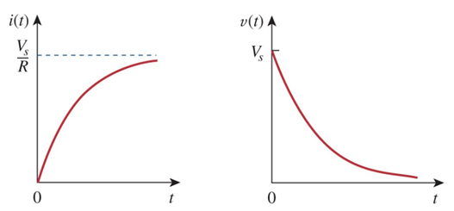
First Order Transient Circuits
Step Response of RL Circuit
After a sufficiently long time:
This yields:
To determine A:
Complete response:

Slide 37
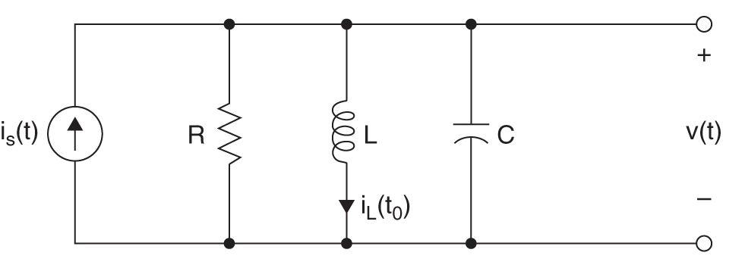
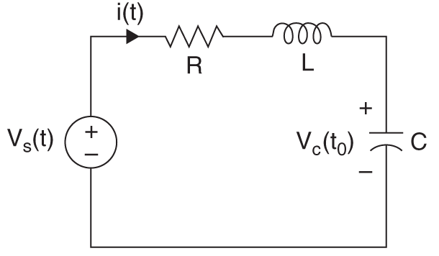
Second Order Transient Circuits
Second Order Transient Circuits
The previous passage considered circuits which only required first order differential equations to solve.
However, when more than one “storage element”, i.e. capacitor or inductor is present, the equations require second order differential equations
The analysis is similar to what was done with first order circuits
This time, though we will only consider DC independent sources

Slide 38
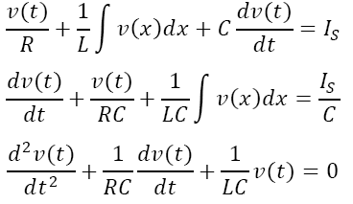
Second Order Transient Circuits
Parallel RLC Circuits

Slide 39
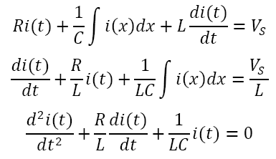
Second Order Transient Circuits
Series RLC Circuits

Slide 40
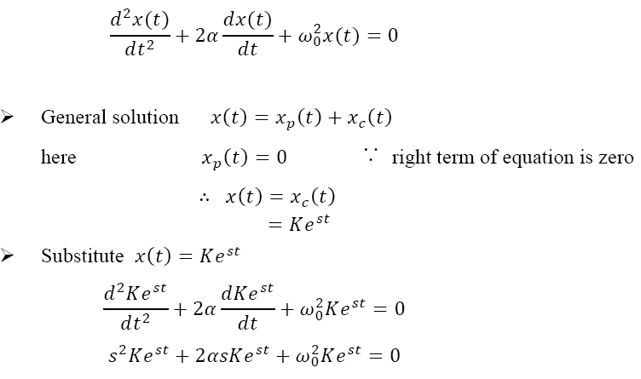
Second Order Transient Circuits
Second order differential equation

Slide 41
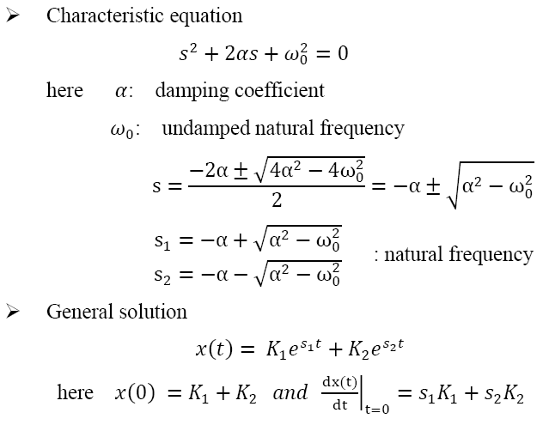
Second Order Transient Circuits
Characteristic equation

Slide 42

Second Order Transient Circuits
Source Free Parallel RLC Circuit
Now let us look at parallel forms of RLC networks
Consider the circuit shown
Assume the initial current and voltage to be:

Slide 43
Second Order Transient Circuits
Source Free Parallel RLC Circuit II
Applying KCL to the top node we get:
Taking the derivative with respect to t gives:
The characteristic equation for this is:

Slide 44
Second Order Transient Circuits
Source Free Parallel RLC Circuit III
From this, we can find the roots of the characteristic equation to be:
As in last time, there are three scenarios to consider.

Slide 45
Second Order Transient Circuits
Damping
For the overdamped case, the roots are real and negative, so the response is:
For critically damped, the roots are real and equal, so the response

Slide 46
Second Order Transient Circuits
Underdamped
In the underdamped case, the roots are complex and so the response will be:
To get the values for the constants, we need to know v(0) and dv(0)/dt.
To find the second term, we use:

Slide 47
Second Order Transient Circuits
Underdamped II
The voltage waveforms will be similar to those shown for the series network.
Note that in the series network, we first found the inductor current and then solved for the rest from that.
Here we start with the capacitor voltage and similarly, solve for the other variables from that.

Slide 48


Second Order Transient Circuits
Responses for Three Degrees of Damping

Slide 49


Second Order Transient Circuits
Step response of a series RLC circuit
Find v(t) and i(t) for t>0, Consider R=5, 4, 1Ω

Slide 50
Second Order Transient Circuits
General Second Order Circuits
The principles of the approach to solving the series and parallel forms of RLC circuits can be applied to second order circuits in general:
The following four steps need to be taken:
First determine the initial conditions, x(0) and dx(0)/dt.
Turn off the independent sources and find the form of the transient response by applying KVL and KCL.
Depending on the damping found, the unknown constants will be found.
We obtain the stead state response as:
Where x(∞) is the final value of x obtained in step 1

Slide 51


Second Order Transient Circuits
Example 4.7
Fine voltage $v\left(t\right), for t>0$.
a) R=2/5Ω, b) R=1/2 Ω, c) R=1 Ω

Slide 52


Second Order Transient Circuits
Example 4.8
Fine voltage $v\left(t\right), for t>0$.

Slide 53
Homework
Homework
Solve Problems 4.6, 4.22, 4.42, 4.54, 4.55
Read Text Chapter 5.
Prepare Presentation

